Slide 1
Springboard Data Science Capstone Project Predict Interest Rate
Dan Wang
Jun 5th, 2020

Slide 2
Introduction
Interest rate is important for both borrowers and lenders.
Borrowers: lower interest rate
Lenders: tradeoffs between higher interest rate and lower default risk

Slide 3
Clients
Borrowers, lenders, investment banks, mortgage companies and other companies engaged in lending business.
Benefits for Borrowers:
Compares variety offers
Right time to get a loan
Better financial budget plan
Improve credit to get desired interest rate
Benefits for Lenders:
Make better financial plans
Better understanding tradeoffs situations
Be competitive in lending market

Slide 4
Data Acquisition and Cleaning
Dataset acquired from Kaggle.com
https://www.kaggle.com/denychaen/lending-club-loans-rejects-data
Dataset size: 2.6M records and 150 feature
Purpose: predict interest rate of loans

Slide 5
Data Acquisition and Cleaning
Remove unmeaningful features and records:
Features Threshold: 10,000 missing values
Records Threshold: 40 missing values
Dataset features type:
Numerical features: Remove |Pearson correlation|>=0.9
Date time features: keep year information only
String features: Label encoder method
Missing values:
KNN Imputer: mean of most similar neighbors

Slide 6
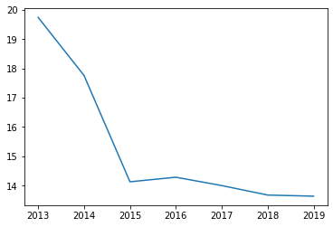
Data Split and Evaluation Metrics
Data Split
Interest drop: 19.74% to 13.63%
Training set: Year 2013, 2014, 2017 , 2018 and 2019
Testing set: Year 2015 and 2016
Evaluation Metrics:
MSE(mean squared error):
The lower value, the better performance
R-Squared:
Values between 0 and 1
The larger value, the better performance

Slide 7
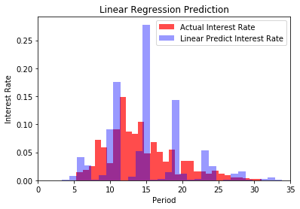
Models
Linear Regression:
P-values greater than 0.05 are non-essential features and get eliminated from dataset
Dataset size: 0.3M records and 32 features
Evaluation metrics:
MSE: 2.6593
R-Squared: 0.8881

Slide 8
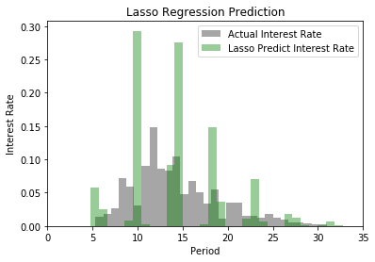
Models
Lasso Regression: (L1 regularization)
Optimize linear regression: reduce dataset complexity and avoid overfitting
Alpha=0.01: Grid search cross validation
Dataset size: 0.3M records and 21 features
Evaluation metrics:
MSE: 2.1617
R-Squared: 0.9091

Slide 9
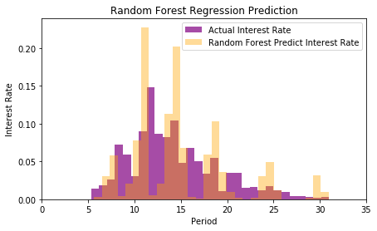
Models
Random Forest Regression:
Deal with non-linear shape
Rank features by node’s purity
Dataset size: 0.3M records and 39 features
Evaluation metrics:
MSE: 2.2306
R-Squared: 0.9062

Slide 10

Model Comparison
Preference: Lasso Regression
Less feature used
Less time consuming
Better performance

